Slide 1

Maven Rewards Challenge
Mohammadhadi Shahhosseini

Slide 2

Overview
01

Slide 3
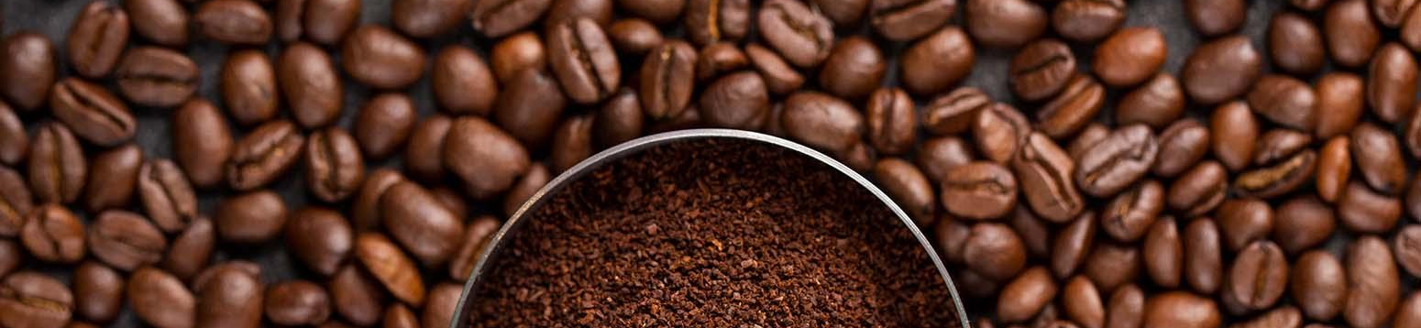
Challenge Objective
In this Challenge, we’ll play the role of a Sr. Marketing Analyst at Maven Cafe.
We've just run a test by sending different combinations of promotional offers to existing rewards members. Now that the 30-day period for the test has concluded, the task is to identify key customer segments and develop a data-driven strategy for future promotional messaging & targeting.

Slide 4

ABOUT Data Set
COFFEE
Data that simulates the behavior of Cafe Rewards members over a 30-day period, including their transactions and responses to promotional offers. The data is contained in three files: one with details on each offer, another with demographic information on each customer, and a third with the activity for each customer during the period. The activities are divided into offer received, offer viewed, offer accepted, and transaction. For a transaction to be attributed to an offer, it must occur at the same time as when the offer was "completed" by the customer.

Slide 5
Tables
 | Field | Description
Offers | offer_id | Unique offer ID (primary key)
 | offer_type | type of offer: bogo (buy one, get one), discount, or informational
 | difficulty | minimum amount required to spend in order to be able to complete the offer
 | reward | reward (in dollars) obtained by completing the offer
 | duration | days a customer has to complete the offer once they have received it
 | channels | list of marketing channels used to send the offer to customers

Slide 6
Tables
 | Field | Description
Customers | customer_id | Unique customer ID (primary key)
 | became_member_on | Date when the customer created their account (yyyymmdd)
 | gender | Customer's gender: (M)ale, (F)emale, or (O)ther
 | age | Customer's age
 | income | Customer's estimated annual income, in USD

Slide 7
Tables
 | Field | Description
Events | customer_id | Customer the event is associated with (foreign key)
 | event | Description of the event (transaction, offer received, offer viewed, or offer completed)
 | value | Dictionary of values associated with the event (amount for transactions, offer_id for offers received and viewed, and offer_id & reward for offers completed).
 | time | Hours passed in the 30-day period (starting at 0)

Slide 8

02
Data Preparation & Feature Engineering

Slide 9
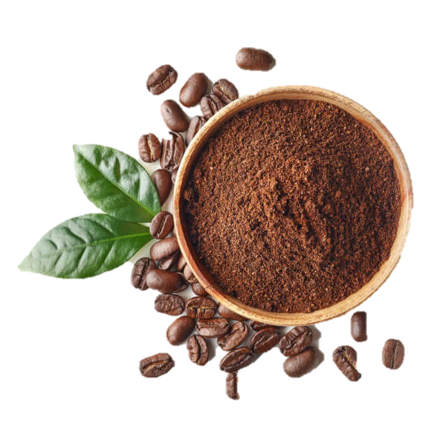
Customers
Offers
Events
Merge
Final Dataset
Feature Engineering
Data Cleaning
Calculated features like membership_duration, time_elapsed, total_spent, num_transactions, and offer completion rates.
Created lagged variables to capture time between offer receipt and completion.
Merged customer interaction data (received/completed offers, transaction data).
Extracted relevant fields (e.g., offer_id, reward, amount) from JSON-like structures.
Corrected data types.
Removed rows with missing income.

Slide 10

03
ANALYSIS
Unsupervised Customer Segmentation

Slide 11
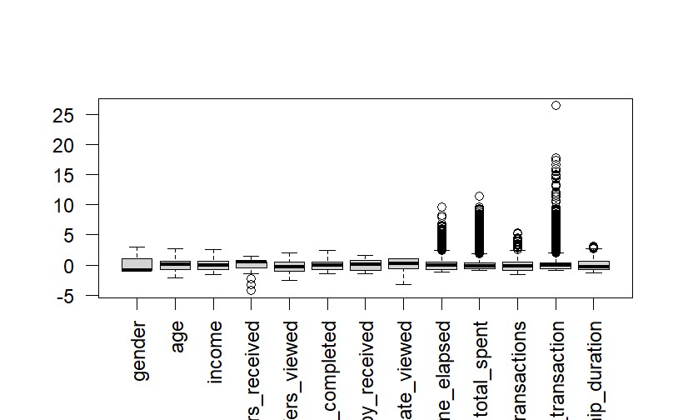
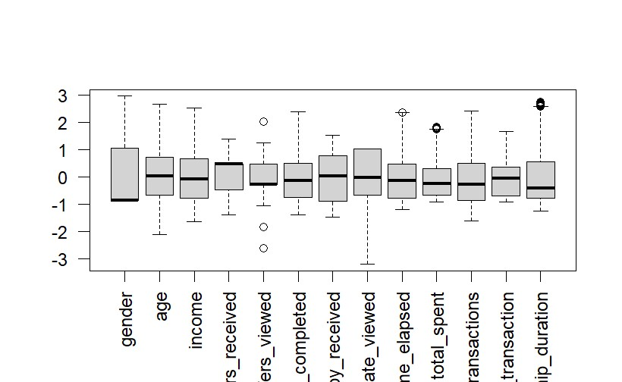
Data Preparation & Outlier Detection
Encoded categorical data (e.g., gender) to numeric.
Normalized data for analysis.
Created membership_duration feature.
Identified and removed outliers using IQR method.
Removing about 2000 outliers

Slide 12
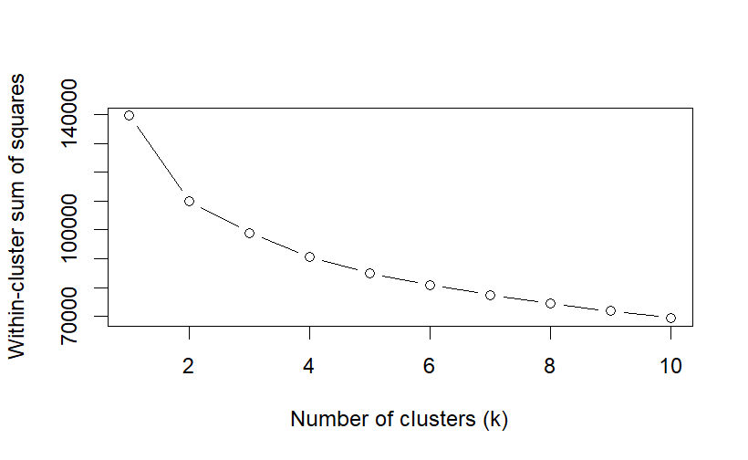
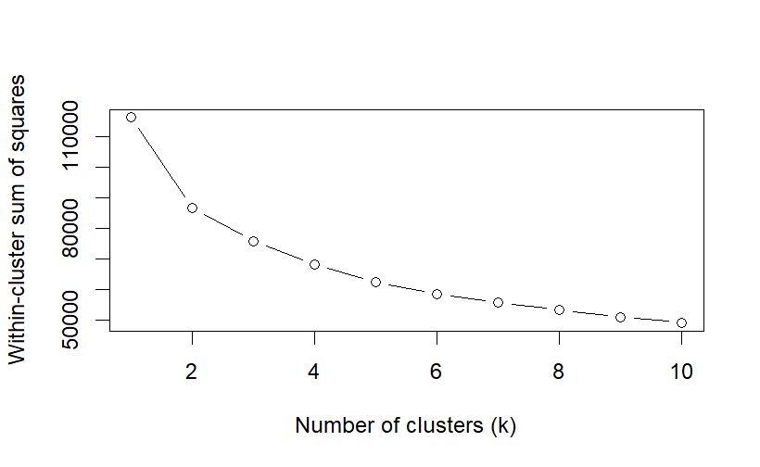
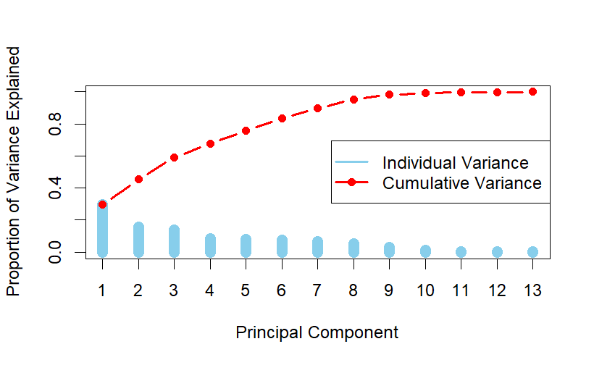
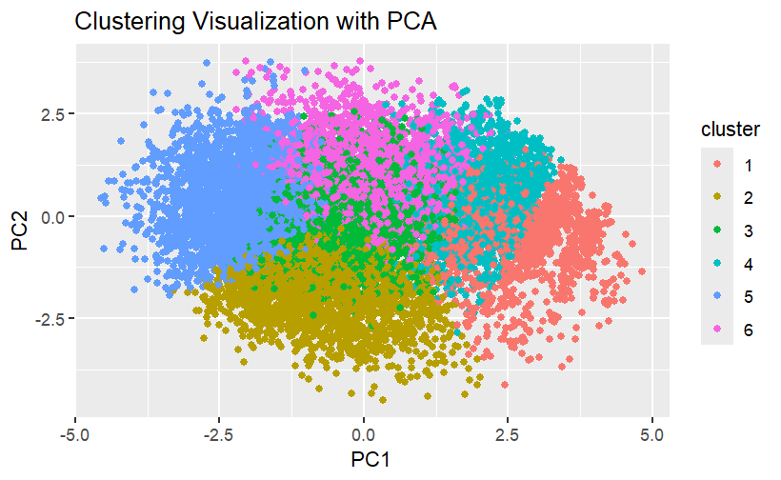
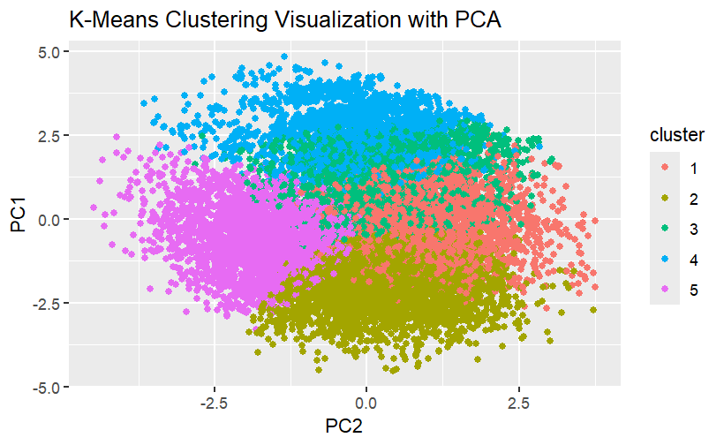
K-Means clustering on original and PCA data.
Original Data
PCA Data
PCA reduced dimensions: top 6 components explain 84% variance.
Elbow method used to determine k = 6 clusters.

Slide 13
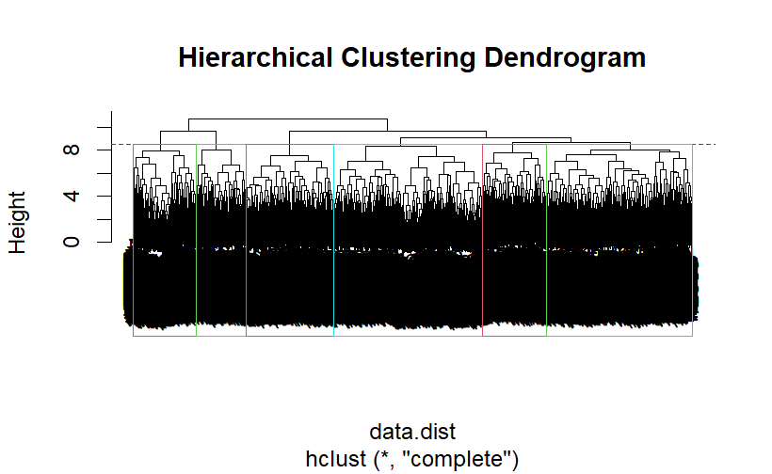
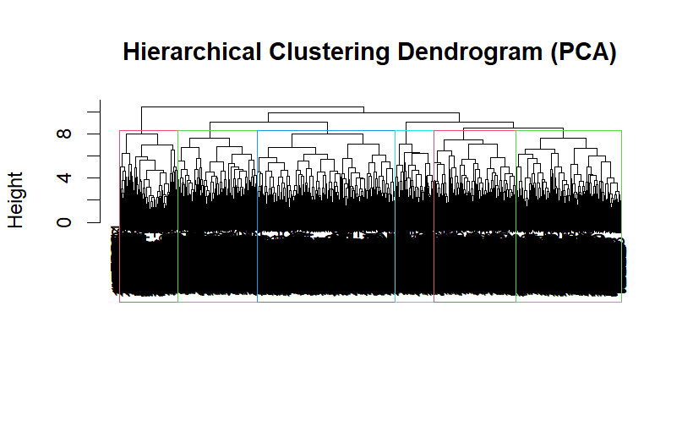
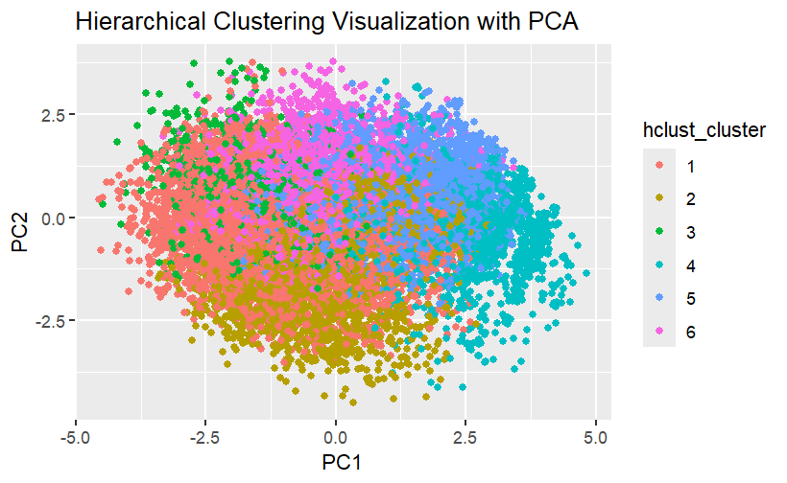
K-Means clustering on original and PCA data.
Original Data
PCA Data
Dendrogram visualization with 6 clusters.

Slide 14

ANALYSIS
04
Supervised Offer Personalization

Slide 15
Overview Flowchart
Data Loading & Preparation
Feature Engineering
Modeling
Evaluation
Load Data & Handle Missing Values
Convert Data Types
Create Features (e.g., Membership Duration)
Encode Categorical Variables (One-Hot /Ordinal)
Train XGBoost Model
Handle Class Imbalance (Oversampling /Weights)
Evaluate Model (Precision, Recall, F1, Accuracy)

Slide 16

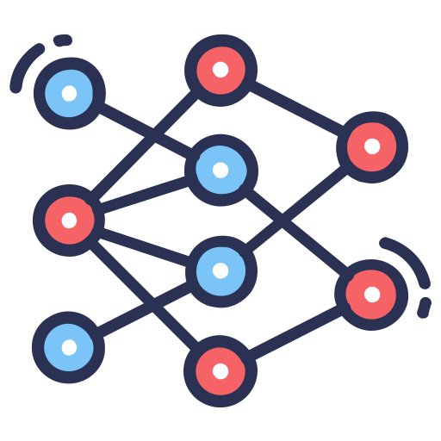


Model Building -
Data Split
Parameters
Handling Bias
70% Train
30% Test
Learning rate (eta) = 0.3
Max depth = 6
Evaluation metric: mlogloss
Applied class weights to account for imbalance.
Implemented oversampling for the minority class (informational offers).

Slide 17
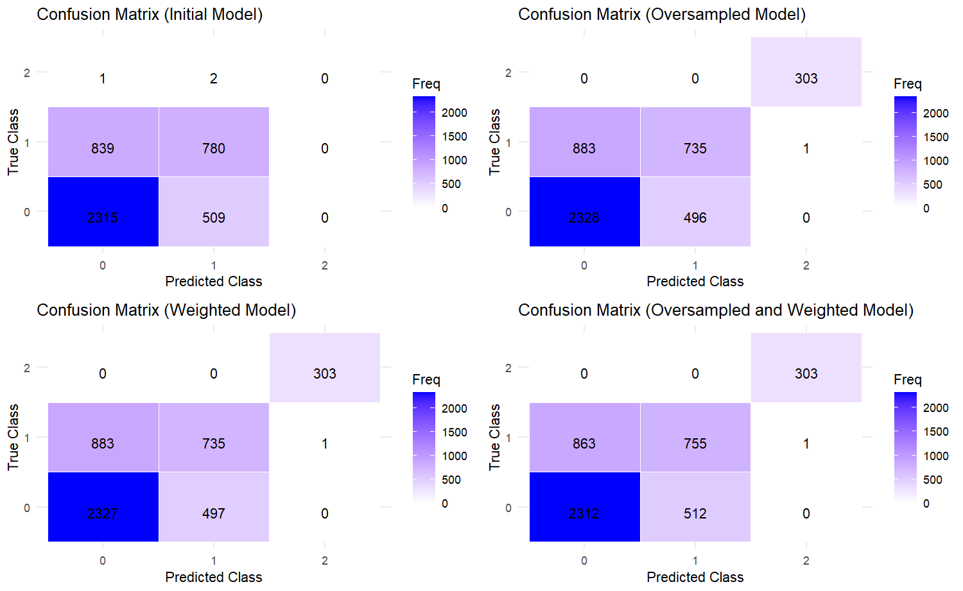
Results and Metrics

Slide 18
Results and Metrics
 |  | Class 1 | Class 2 | Class 3
Initial Model | Precision | 0.7338 | 0.6042 | NA
 | Recall | 0.8198 | 0.4818 | 0.0000000
 | F1 - Score | 0.7744 | 0.5361 | NA
Weighted Model | Precision | 0.7316 | 0.6067 | NA
 | Recall | 0.8251 | 0.4725 | 0.0000000
 | F1 - Score | 0.7755 | 0.5312 | NA
Oversampled Model | Precision | 0.7249 | 0.5966 | 0.99671
 | Recall | 0.8240 | 0.4540 | 1.00000
 | F1 - Score | 0.7713 | 0.5156 | 0.99835
Oversampled and Weighted Model | Precision | 0.728189 | 0.5958958 | 0.9967105
 | Recall | 0.8186969 | 0.4663372 | 1
 | F1 - Score | 0.7707951 | 0.5232155 | 0.9983526
69 %
69 %
70.9 %
71 %

Slide 19

THANKS
PO
PI
C ·
CA
FE

